Slide 1
Name
Institution
Date
Anti-drone systems

Slide 2
Introduction
Drones have been experiencing a growth that is very explosive in the digital world today and are used widely in many areas including monitoring of traffic, aerial photography, and management of disaster among others
prevalent drone uses have posed great threats to both personal privacy and public security.
For example, an attack carried out where an attacker straps explosive or other materials which are dangerous to a drone.
Another example is where drones are used to spy private information of an inhabitant where a camera of high-fidelity is attached to the drones.
Notes:
The frequency of these threats has been significantly on the rise and therefore, it is of great significance to ensure anti-drone systems are deployed into areas of sensitivity and geofencing-free.
In these areas, an anti-drone system will adequately detect any drone when flinging in the sensitive areas and estimate its location for drone defence including controlling, detecting or jamming the drone that has been detected.
It has been a challenging task to detect drones since their size is small and flies at a low speed and a low altitude.
Technologies used in anti-drone include audio surveillance, radio frequency (RF) surveillance, video surveillance, and radar surveillance

Slide 3
Background
Countering unmanned aircraft issue has been given a thought by groups of the military for quite several years.
NATO had launched in 2003 a ten-year study on how to defend against small, low, slow aerial targets.
Drones were operated in both Syria and Iraq conflicts.
ISIS had claimed to have used drones more than 200 times for accurate missions.
Notes:
Many people worldwide have worried about drones being used domestically to scale terrorist attacks.
Germany's Pirate Party in 2013 for instance flew a small drone close proximity to Angela Merkel at a rally that was open-air.
This led to so much speculation about how drones are used with ease and could be used to attack a highly secured area.
When it comes to the issue of drones, air defence systems are ineffective despite being given the mandate to traditionally protect airspace from aircraft which are manned.
The anti-craft radars used by military are only designed to detect objects that are large and moving very fast and therefore are unable to pick drones which are small, slow and low-flying.
It is ineffective to rely on visual observation so to detect drones and hence the need for the anti-drone system.

Slide 4
Surveillance Technologies
They include audio surveillance, radio frequency (RF) surveillance, video surveillance, and radar surveillance
Notes:
Radar surveillance- This surveillance technology is very useful when detecting and tracking a large aircraft. This technology however, when tracking and detecting drones, it faces severe challenges from the fact that across section drones have a low radar while they fly, they do so at a speed and an altitude which is very low
Radio Frequency (RF)
Specific frequency bands e.g. 5.725-5.825GHz is the one being used for communication between the market existing or customized drones with their controllers for DJI Phantom 4. In a sensitive practical environment, however, Radio Frequency based drone detection becomes quite a challenge as there exist many RF signals including WiFi signals.
Video surveillance
The detection of drones with the basis on video images is a problem of object detection essentially in the computer vision area and recognition of the pattern. The appearance feature which includes contour lines, edges, or colors can be used while detecting an object.
Audio Surveillance
A system that has been equipped with acoustic sensors can be used to detect, classify, and localize drones. This is because drones have motors and propellers which rotate fast and whenever they are on a flight they generate sounds. The analysis in both time domains and frequency domains can be utilized in order to obtain the drones' acoustic signatures

Slide 5
Examples of anti-drone systems
They include Drone-Detector, Drone-Detector , Dedrone, ARDROINS, and DroneShield among others.

Slide 6
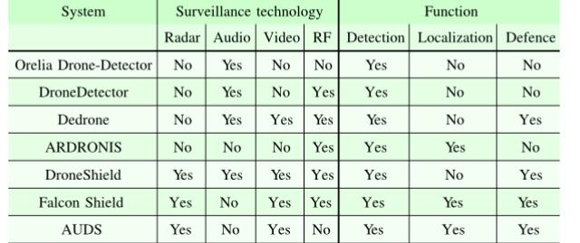
Anti-drone systems
Notes:
The above table illustrates the surveillance technologies which are utilized in already available anti-drones systems and most of these systems combine more than one surveillance technologies. The reason for this is because more than one technology offers for information and accuracy for detecting and localizing a drone.

Slide 7
How anti-drones are used
These systems have commonly been used on the battlefield where they ensure base protection and complement weapons existing which includes surveillance platforms and counter-mortar systems.
Anti-drones systems are also seeing big demand in portable and mobile systems where they can be used to ensure the security of convoys and ground units
Notes:
They are also used in airports for airspace protection, VIP protection, used at prisons in countering smuggling operations, and used as security during sports games and even political rallies.
Will be used in future applications will include port security, personal use in private property, and as a defence in sensitive facilities.

Slide 8
Growing market
Anti-drone market by 2026 will reach over $3 billion.
In terms of revenue, the defence and military segment dominated the market globally in 2015.
In the forecasted period, there is an expectation that the global market will be dominated by North America.
Notes:
The drone misuse incidence which has been significantly rising is expected to drive this market as well.
Drones have continued to be used by traffickers and smugglers for activities that are malicious and criminal.

Slide 9
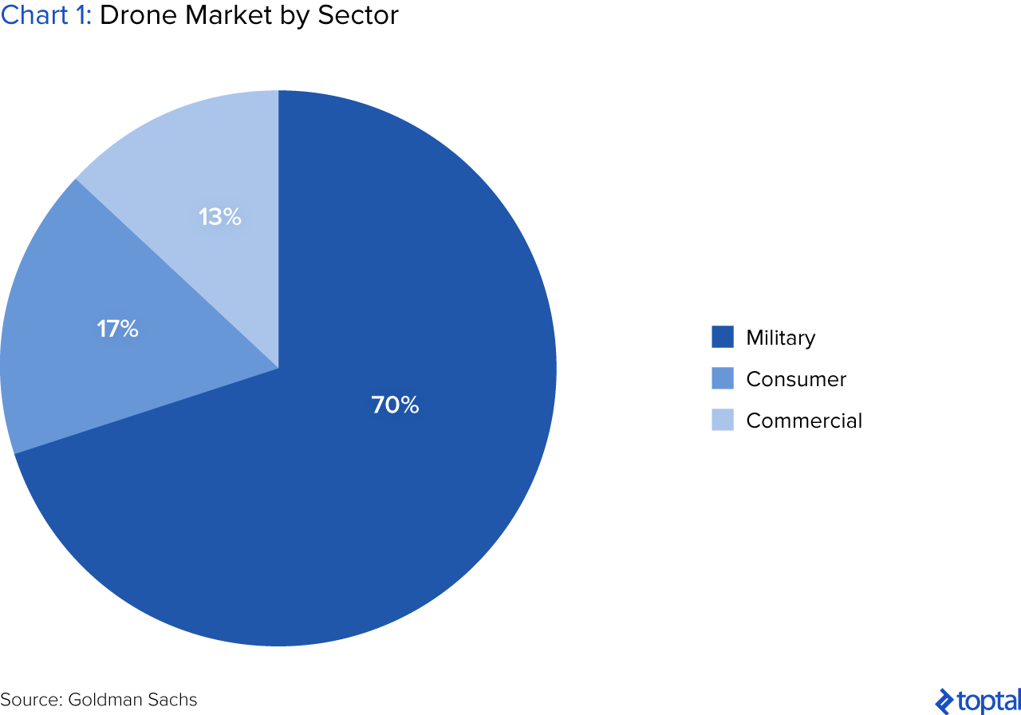
Drone market by sector
Notes:
The chart shows the drone market by sector which reflects anti-drone system as well.

Slide 10
Market leaders
The military anti-drone market leader is the United States of America followed by Israel.
Israel is the largest exporter of an anti-drones system for military and sells to the United Kingdom, China, and India.

Slide 11
Trends
The latest technology evolution is enabling anti-drones systems to spread their wings across many sectors.
These were only available for purposes of the military some years ago and their power is often used in harnessing their power across many applications.
While drones are filling our skies, the anti-drones system will also be a common thing and more investments will be made and this will be a game-changer in the industry as technology innovation continues to be revealed
Notes:
Anti-drones will be significantly used to combat crimes and security threats as more drones continue to be used.
Many countries will soon realize the threats that can be avoided by the use of the anti-drone system.
Few years to come, massive investments will be made by many countries toward exploring the full benefits of anti-drones systems.

Slide 12
Challenges
Challenges come along with anti-drones systems particularly in their performance level, policy, practicality and legality.
Therefore, these challenges should be considered by any group planning or hopping into using these systems as well as those establishing the role technology plays in drone's integration into the airspace.
Notes:
They include Distinguishing between legitimate and illegitimate drone, detection effectiveness, False negatives and false positives, Lack of standards, Interdiction legality, and Interdiction hazard

Slide 13
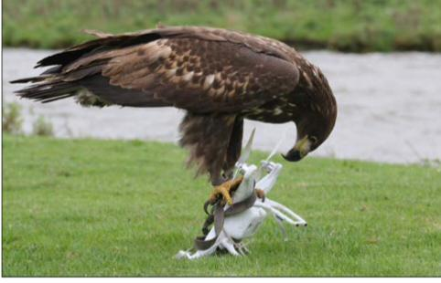
Challenges

Slide 14
Conclusion
Technology has made it for more drones to continue being used.
These drones have become faster, smaller, cheaper and deadlier as well as the ability for adding a payload.
This calls for necessary countermeasures to ensure the threat posed by these drones is dealt with accordingly.
Wide arrays of threats are posed by drones to both public and national security.
This has demanded the growth of anti-drones systems which are flexible, and multi-layered.
Anti-drone systems technologies have also significantly evolved to counter the threat posed by drones by ensuring customized anti-drones systems are produced.
This has led to a wide range of technologies being used in anti-drone systems which includes radar, audio, video and radio frequency (RF) surveillances.
There are many anti-drone systems available in the market today which apply more than one combination of these technologies.
These systems are extensively applied in many scenarios and have a big capability and their market continues to grow as the drone industry grows.
However, despite the good things brought by anti-drone systems, they have some challenges which include detection effectiveness, interdiction hazards, and legality interdiction among many others.

Slide 15
References
[1] A. H. Michael, “COUNTER-DRONE SYSTEMS”, February 2018
[2] S. M. Saeed, C. A. Balanis, Life Fellow, IEEE and C. R. Bircher, “Radiation of Flexible Reconfigurable Antenna with Curved Cylindrical Configuration”,
[3] W. Zwijnenburg and F. Postma, “Unmanned Ambitions: Security Implications of growing proliferation in emerging military drone markets”

